Slide 1
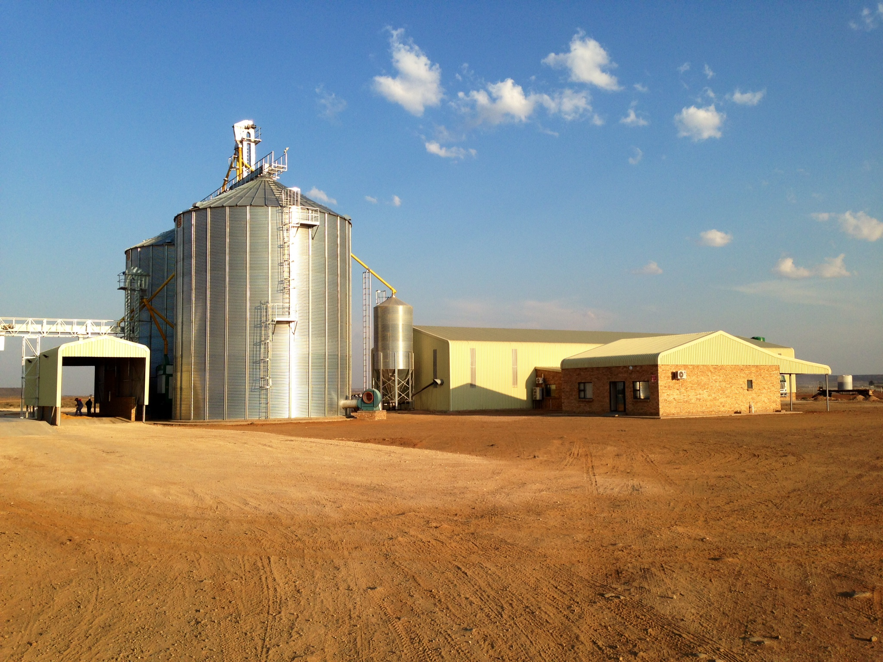
JOCHWE POPCORN
Growing quality popcorn is an art

Slide 2
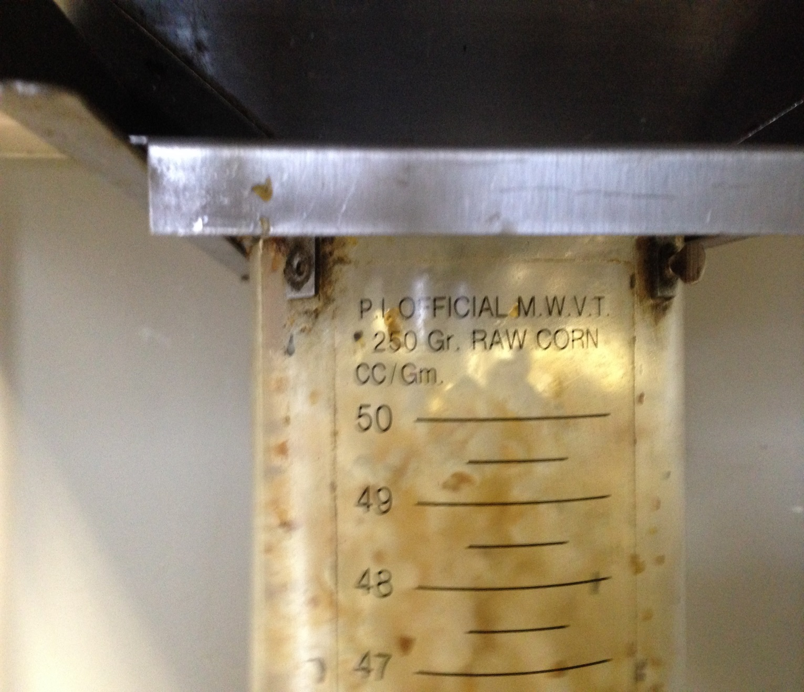
Project Description
Jochwe Popcorn’s mission is to produce the highest possible quality popcorn, store it without any moisture loss and deliver timeously throughout the year to local and international customers.

Slide 3
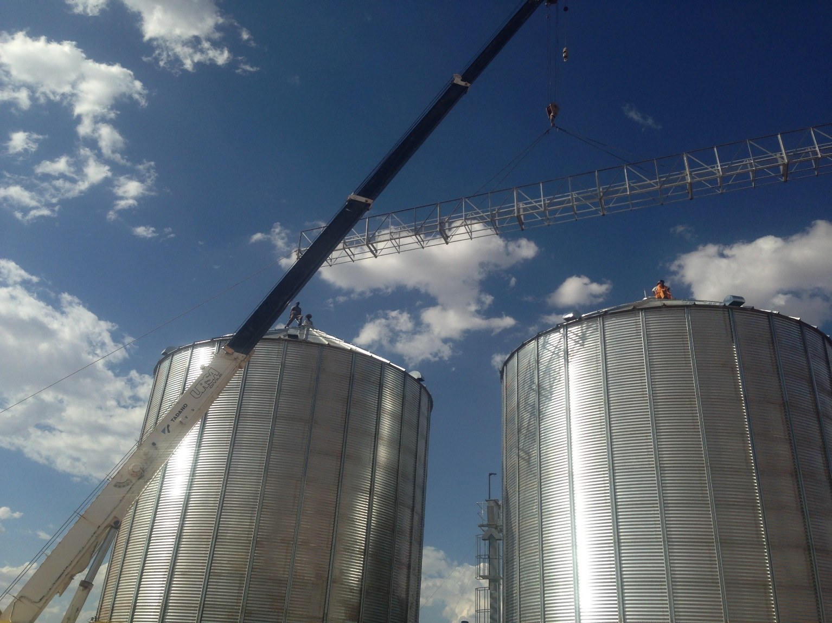
Introduction
Jochwe Popcorn is family owned and started in 2007
Jochwe produce about 3000 tons of popcorn on its own and buy in an additional 2000 tons for the local market
Storage capacity of 2 silo of 1750 tons each
Factory capacity of 7 tons per hour
The factory is a new facility and has SAGAP accreditation for exporting
BEE status - level 4
Notes:
May require more than one slide

Slide 4
Quality Management
Crop: | 2015 | POPCORN YELLOW BUTTERFLY
Batch Quality Testing Results: |  |  |  | Jochwe Grading system:
Test | Moisture | Pop Ratio |  | POP.RATIO | GRADE
Btatch 1 | 14.20 | 45.0 |  | 48-50 | PM+8
Btatch 2 | 13.80 | 44.0 |  | 46-48 | PM+6
Btatch 3 | 14.00 | 44.0 |  | 44-46 | PM+4
Btatch 4 | 14.50 | 44.0 |  | 42-44 | PM+2
Btatch 5 | 14.50 | 44.0 |  | 40-42 | PM
Btatch 6 | 14.50 | 44.0 |  | 38-40 | P1
Btatch 7 | 14.30 | 44.0 |  | 36-38 | P2
Averg | 14.26 | 44.14
 | Grade: | PM+4
Jochwe has introduced a new grading system internally to emphasize the difference in the quality of the popcorn.
The aim is to supply a 48 to 50 popping ratio of the popcorn or a grade of PM+8.
Jochwe is currently doing research with fertilizers specialists to get the energy level of the popcorn plant optimal during the growing season to obtain this quality
Notes:
May require more than one slide

Slide 5
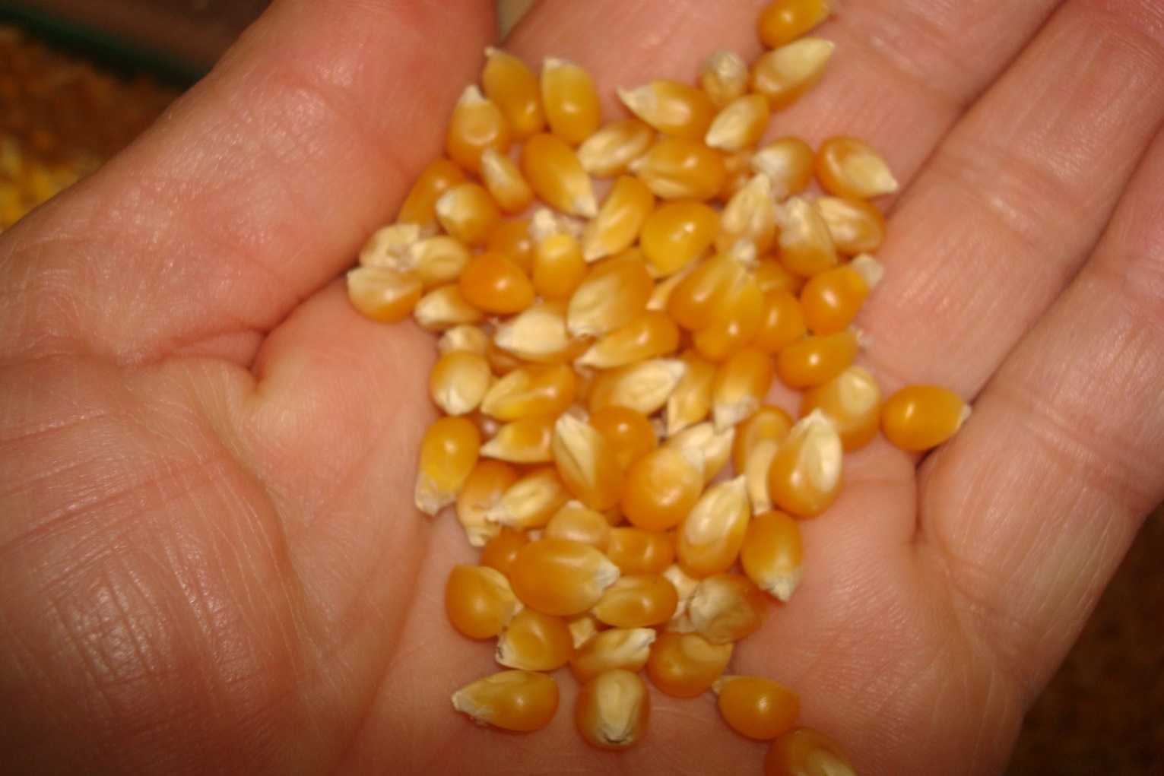
Key Production Areas
Cleaning of popcorn before silo storage
Conditioning of popcorn in the silo’s to maintain moisture for optimum quality
Fumigation of popcorn with phostoxin (gas), leaving no chemical residue on the kernels
Continual testing in our lab in the factory during production
GMO and gluten free
The popcorn hybrids that are planted have been imported form the USA.
This hybrid selection have been evaluated in our area for quality, yield and adaptability.

Slide 6
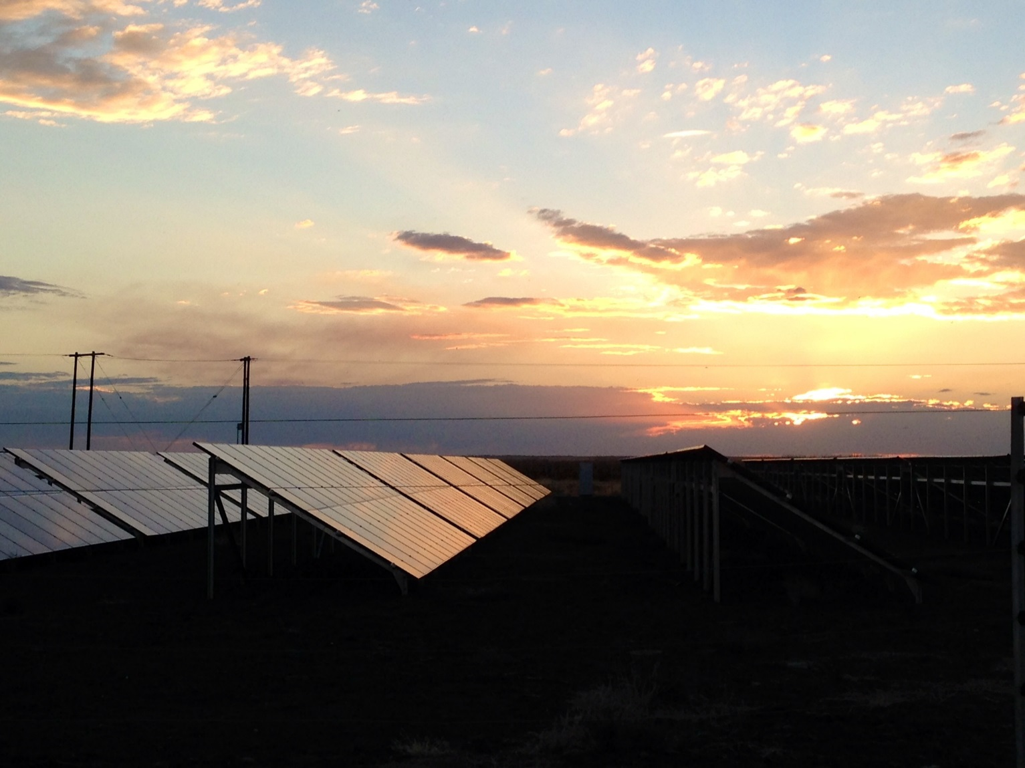
Success Factors
Use of solar plant to generate all electricity for production and processing of popcorn
Objective is to have a zero carbon footprint for production and processing of popcorn.
The solar plant in the picture is 215 kw plant and generates +/- 500 000 KwH yearly.

Slide 7

Success Factors
No burning of stubble on fields
Have increasing organic matter in the soil from 0.2% to 2% in the past 10 years.
Use no-till and strip-till practices to build organic matter and soil structures.
Water in the fields is monitored with probes on an hourly basis to optimize water usage
Use organice base fertilizer

Slide 8
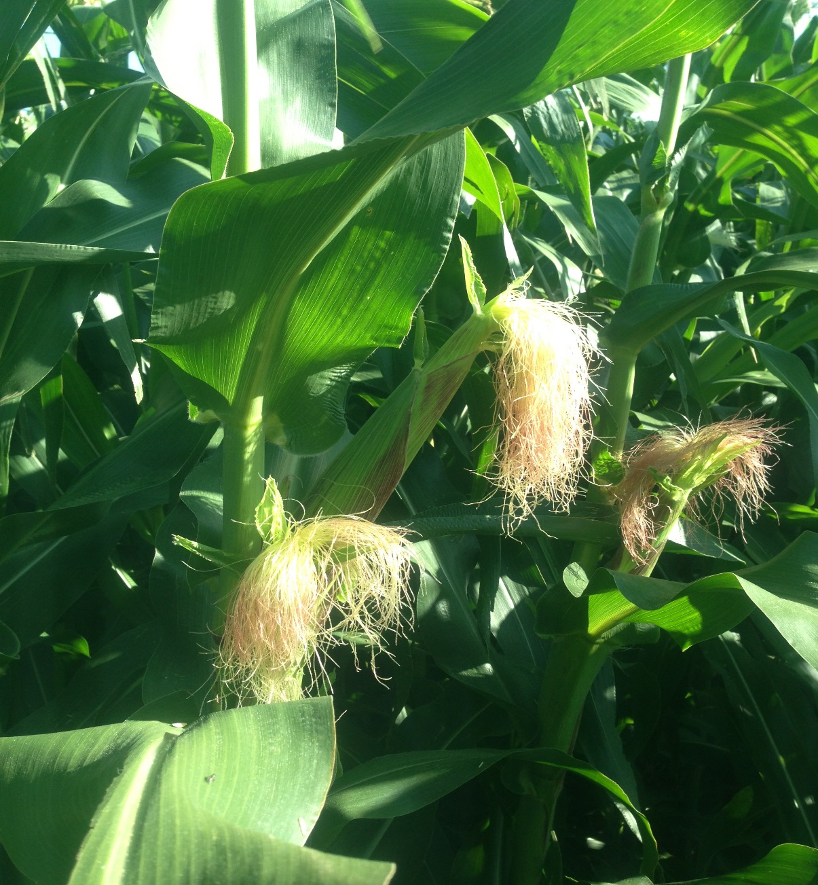
Last words
Thanks for the opportunity
Look forward to doing business in the future.

